Slide 1


What’s going on! 2019/ 2020
What are we all about?
www.getkidsintosurvey.com

Slide 2


Vision
To educate and excite the next generation of surveyors
To better the Industry globally
Elaine Ball elaine@elaineball.co.uk Tel: +44 (0) 7825-517-850 | Get Kids into Survey is a Registered Trademark

Slide 3

Mission
To Educate kids/people on the surveying world incl. equipment, solutions, jobs, different areas of surveying etc.
To nurture and grow our community and our Brand Ambassadors
To work with educators & educate the educator
To work with survey associations around the world
To offer scholarship schemes globally/ building an education pot of gold
Elaine Ball elaine@elaineball.co.uk Tel: +44 (0) 7825-517-850 | Get Kids into Survey is a Registered Trademark

Slide 4


Who is behind this?
Meet Elaine Ball - “this started out as a bit of fun, which grew legs and has run around the world several times. So Elaine’s mission is :”let’s see how good my marketing skills actually are and get kids into Survey!” - Yes Elaine is into horses and that’s her with her neddie ‘Finn’!
Meet Elly Ball - Before you ask, Elaine and Elly are not the same person - they are sisters! Blame their parents! Both Geospatial Geeks!
With the demand growing to help the industry, we decided to set up #GetKidsintoSurvey as a business in Feb 2019 - the business is unique as we have to make money to help put it back into growing the demand for the Geospatial World - however we have set up an Educational Fund to support local charities and small businesses who are doing good in our industry - like Captain Alice of Mini Map Makers.! Our Mission is to offer “Scholarships” to kids in the near future! So money raised for this will go into the education fund!

Slide 5

How?
Marketing
Social media - Facebook, Instagram & LinkedIn
Exhibitions
Magazines
PR
Events
Word of mouth
Through fun educational content, material and media
Posters - see shop
Activity Sheets
AR
Video
Comic Book
Curriculum
Lesson Plans (for teachers)
Elaine Ball elaine@elaineball.co.uk Tel: +44 (0) 7825-517-850 | Get Kids into Survey is a Registered Trademark

Slide 6
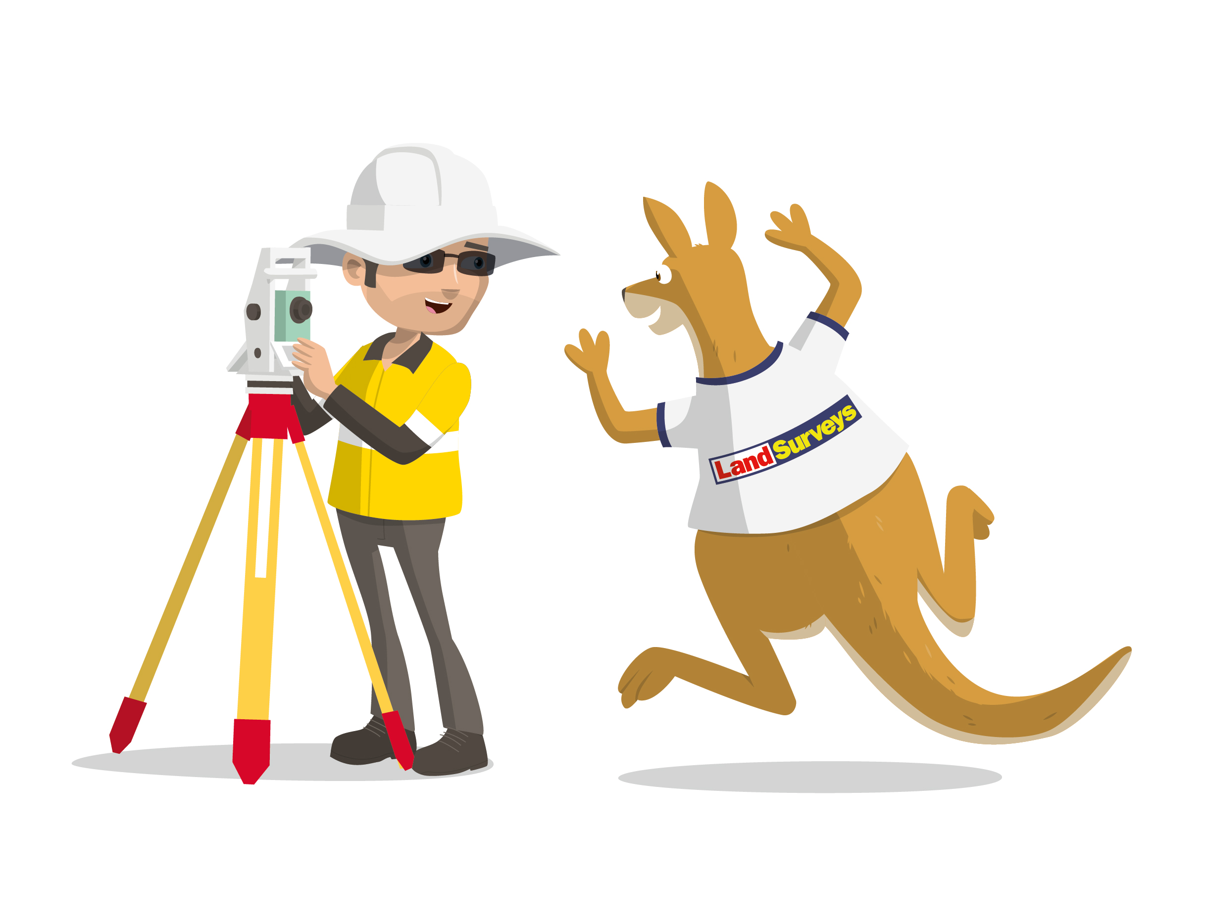
How?
Working closely with Brand Ambassadors & Distributors worldwide
Building a strong community
Working with Educational System (with help from the Brand Ambassadors)
Working on curriculum for schools and other educational organisations (Alison Watson)
Having a clean & easy system for Sponsors to help
Providing Scholarships through % of sales and donations on website = Education Fund
Working and collaborating with any similar communities/organizations with same goals
Elaine Ball elaine@elaineball.co.uk Tel: +44 (0) 7825-517-850 | Get Kids into Survey is a Registered Trademark

Slide 7
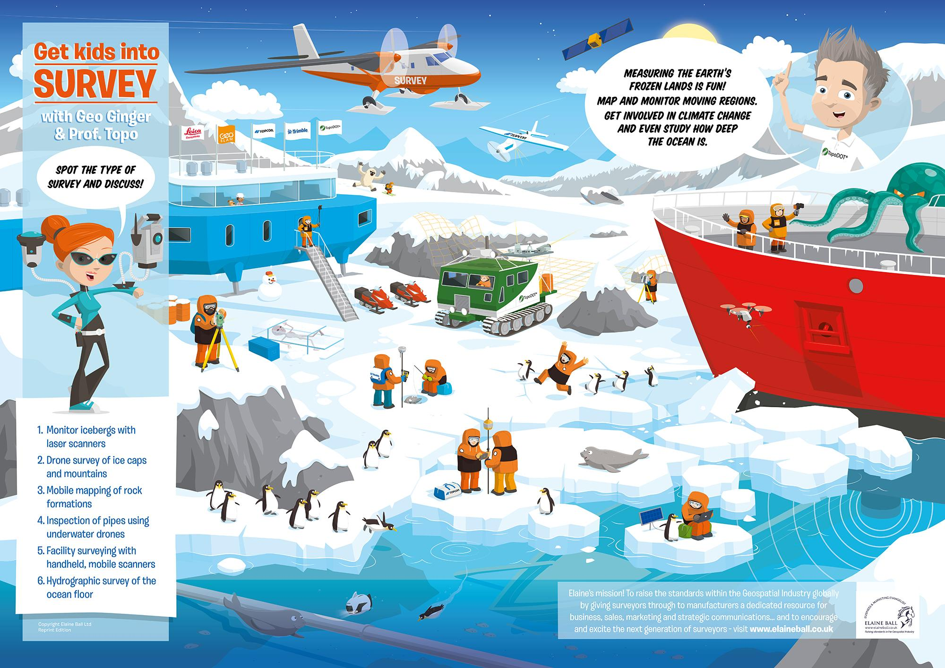
How do I help NOW?
Become a Sponsor by supporting our posters/ colouring in sheets - prices here
Become a Sponsor of the Comic Strip - prices here - have your own cartoon character!
Become a Brand Ambassador - those individuals / companies who help SPREAD THE WORD - ask me!
Become a Distributor - help us spread the ultimate word by helping us keep ‘shipping costs’ down so we can give posters away! We pay for printing, you ship to the end user (school, surveyor, teacher, kid) - ask me!

Slide 8
Benefits to sponsors
Be part of the story!
Exposure of your brand: 3000 copies of each poster; plus social media exposure
Primary Target audience: (first point of contact)
Industry (socials and magazines) - (Industry are our first point of contact who then take to schools)
Secondary Target audience: (we are working with schools to build our content into lesson plans)
Children 6-12 years (schools)
Teachers/ Parents (National Geographic for Kids)
Sponsor are seen as promoting the Industry - wellbeing - being part of the community
Target audience becomes emotionally connected to Get Kids into Survey through Cartoons
Characters are built into the story and are a way for Industry to build a visible strong brand (simple)
Characters not only subconsciously build your brand with the child thus remember your brand in the future but they become easily identifiable with your target audience (surveyors, land owners, manufacturers… etc)
Get Kids into Survey are a means to market the industry through connections and marketing skills
Elaine Ball elaine@elaineball.co.uk Tel: +44 (0) 7825-517-850 | Get Kids into Survey is a Registered Trademark

Slide 9



GKiS Distributors & Ambassadors
Distributor: Organization /Company or Person distributing our posters in their country/region
Brand Ambassador: Organisation / Company or Person representing GKiS in their local city/town/area/ society
GKiS Team look after Distributors
Distributors to feed into GKiS
Distributors look after Ambassadors
Ambassadors feed into Distributors
Elaine Ball elaine@elaineball.co.uk Tel: +44 (0) 7825-517-850 | Get Kids into Survey is a Registered Trademark

Slide 10






Our Distributors as of Aug 2019
Timothy Burch & Trisha Milburn
National Society of Professional Surveyors
Be a Surveyor website
Young Surveyors Association
The HUB of all State Surveyors
Katie Holt & Anne- Marie
Chartered Institute of Civil Engineering Surveyors
Michelle Brooks
CDM Branding
Surveying: A Life without Limits brand
Surveying Task Force Inc., NSW Surveying Taskforce, Destination Spatial Qld

Slide 11
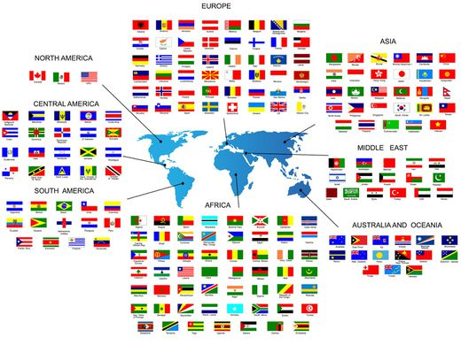
Plan for Distributors
To grow Distributor network to cover all English speaking countries
To expand Distributor network into non English speaking countries
To work with Distributors in non English speaking countries to translate posters.
Distributors to sell own merchandise (Royalty Fee for GKIS). GKIS to regulate quality and set standards.
Distributors to get Finders Fee for getting sponsors for GKiS
Elaine Ball elaine@elaineball.co.uk Tel: +44 (0) 7825-517-850 | Get Kids into Survey is a Registered Trademark

Slide 12




Current Brand Ambassadors
Brand Ambassadors Facebook Group ←
NORWAY
Celina Thom, NOSP - Hordaland
UK
Mark Lawton – Skanska – Geospatial Apprenticeships UK - Royston, South Yorks
Captain Alice – Mini Map Makers, Bedford
Alison Watson – COYO, DEC, Clitheroe
Micki Knight - GeoConnexion – Magazine, column - Cambridge
Caroline Hobden - GeoBusiness – Show helping to promote us - Brighton
The Hydrographic Society - Plymouth
Paul Burrows - #realitycapture guy, Leica - West Midlands
Abigail Tomkins & Katie Holt - CICES, Manchester
Jason Warren & Phil Marsh - Laser Scanning Forum (Northampton & Carlton, S Yorks)
Lauren Holland - Murphy Surveys -London
Mat Kellett - Topcon, Stockon on Teme
Africa
Faical El ADLOUNI, Leica, Casablanca, Morocco
Shayne Ayford, Optron, Capetown, South Africa
Pierre Potgieter - EE Publishers “PositionIT, Capetown, South Africa
Diana Ahiaku - Student Ghana
Joshua Azorliade, Quest Consolidated Ltd, Accra, Ghana
USA
Kent Groh – Stantec | United Surveyors of Arizona - Temple, Arizona
Phil Fedor – Bowman Consulting - Buckeye, Arizona
Ryan Swingley - ESP Associates, Indianapolis, Indiana
Daniel Gomez - BNP Media “POB” - Detroit, Michigan
Farah Etcheverry - Etcheverry Land Surveying, Cottonwood, Arizona
Europe
Isabel Brüstle - Ministerium für Ländlichen Raum und Verbraucherschutz - Stuttgart
Australia
C R Kennedy – (Storage) Melbourne
Matt Rumbelow - Melbourne
Surveying Taskforce NSW
Surveying Taskforce Victoria
Destination Spatial Queensland
Geospatial Science
Paul Mead & Dr Karen Joyce - She Maps, Cairns

Slide 13

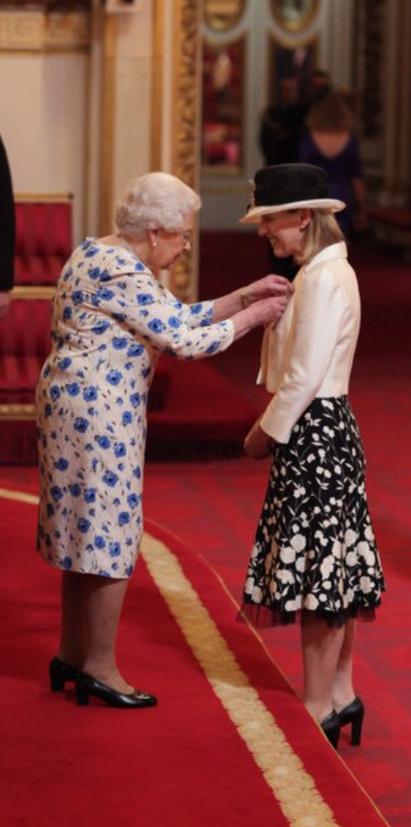
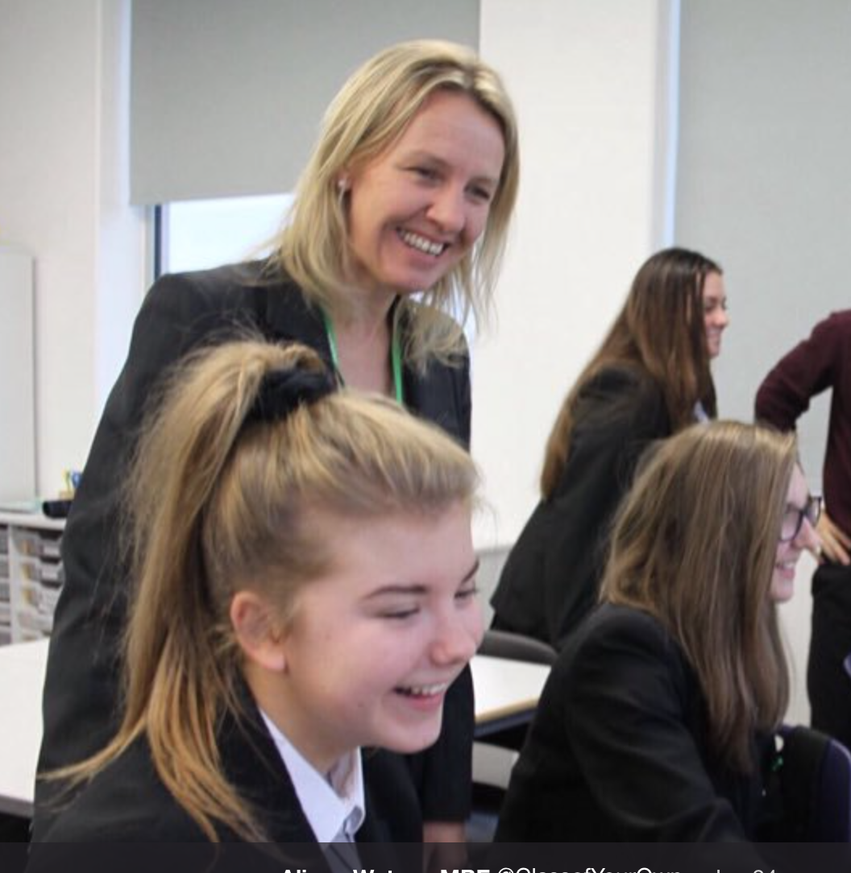

Collaboration 2019 - 2020
Alison Watson provides School Curriculum for 15-18 year olds (GCSE & A-Level) called Design Engineer, Construct
Alison currently writing Surveying GCSE
GKiS to help promote Alison into Schools worldwide
Alison to help GKiS write Curriculum for 8-12 Year olds. (Release at Survey Fest 2019)
GKiS Curriculum feeds directly into DEC Schools
www.classofyourown.com
Host Survey Fest October 2019 together

Slide 14

The Next Poster
- min of 3000 per poster printed
(Over 40,000 posters distributed globally to date)
Offshore UK & USA
Utilities UK, Australia and USA
2020 COMING SOON
See Posters HERE
Click here to Sponsor us!
Elaine Ball elaine@elaineball.co.uk Tel: +44 (0) 7825-517-850 | Get Kids into Survey is a Registered Trademark

Slide 15

Future Posters
Carry on covering all areas of the industry
Work on specialty posters that have a more in depth focus on certain part of surveying/application/solution
Link content with lesson plans so teachers/ parents can use / relieve pressure on teachers
Regionalise Posters into other countries
Special Edition Posters with focus on projects for schools, organizations.
Elaine Ball elaine@elaineball.co.uk Tel: +44 (0) 7825-517-850 | Get Kids into Survey is a Registered Trademark

Slide 16
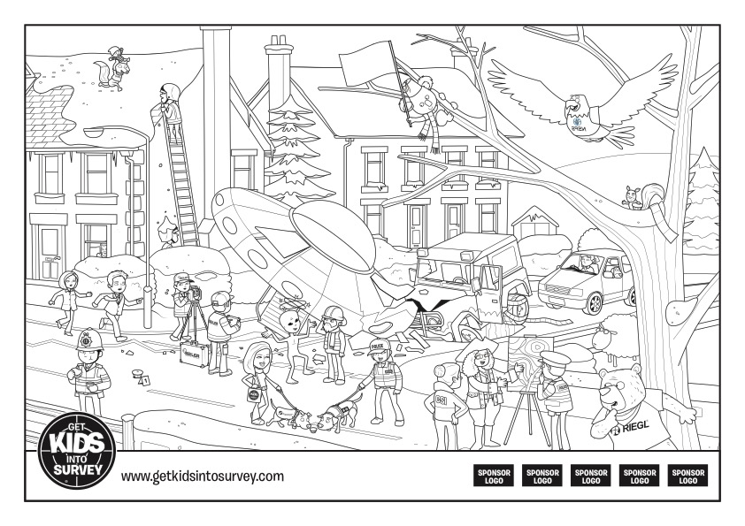
Downloadable PDFs & Fun
Activity Sheets from Posters - coming soon
Colour in
Future Plans for free material
School focused activity sheets - coming soon!
Spot the difference
Where’s GEO Ginger?
Elaine Ball elaine@elaineball.co.uk Tel: +44 (0) 7825-517-850 | Get Kids into Survey is a Registered Trademark

Slide 17

Comic Strip & Book
Comic Strips
Chapter 2: 6 episodes of comic strips, 1 released per month (June – November 2019)
In Print
Ad in Geospatial Magazines:
POB USA - 35,000 circulation
Civil Engineering Surveyor UK - 5,000 circulation
Ad in Nat Geo Kids - UK / Australia / New Zealand (distributed to over 120,000 kids)
Comic Book
Pre-Order in Spring 2020

Slide 18
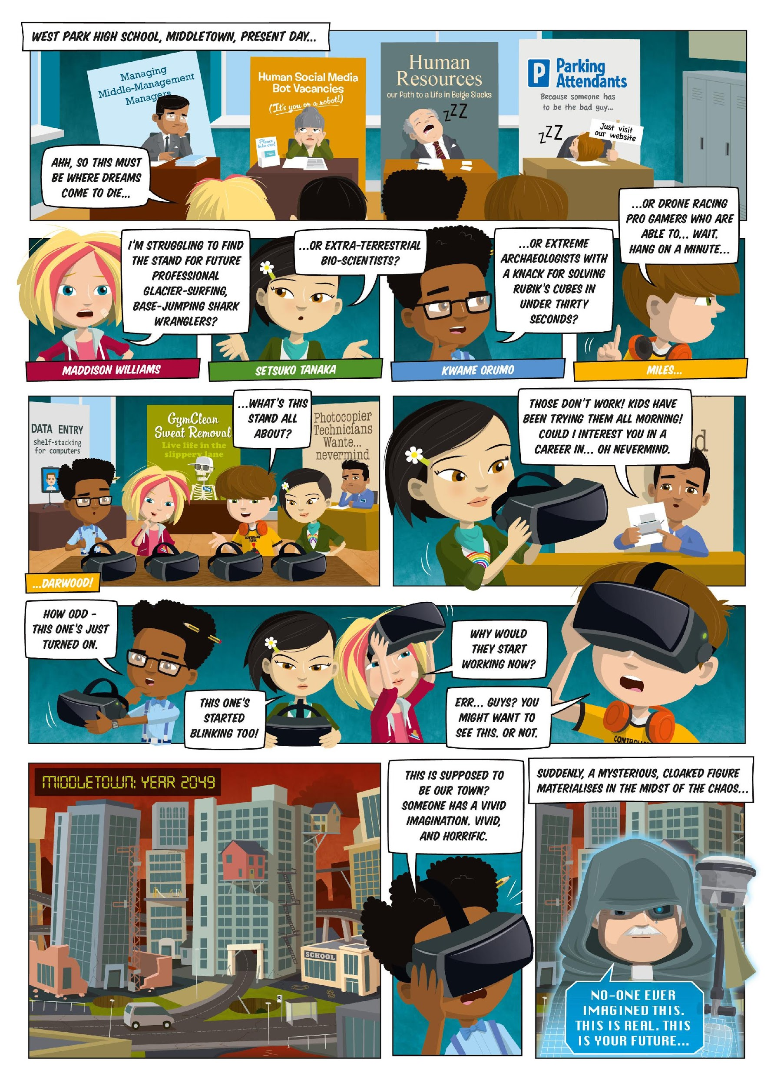
Why the Comic Book?
To teach kids about surveying without them realising
Reaching a larger audience worldwide
To give teachers resources that are fun and engaging for kids/ can use in lessons
To work alongside Comic
Create Educational resources/curriculum for teachers to use to teach through the comic
Augment the Comic Book to make it more appealing to the young generation. Used as an educational tool and link to our kids portal on website.

Slide 19

Augmented Reality for Posters
GEO Ginger (Beta) – May 2019
Showcased at TUC (Orlando) & GEO Biz (London)
45 seconds of animation – fun and educational for viewer
Other Sponsors to Augment their characters in posters
Plan to have fully immersive AR GKiS world 2020/2021
Elaine Ball elaine@elaineball.co.uk Tel: +44 (0) 7825-517-850 | Get Kids into Survey is a Registered Trademark

Slide 20



SURVEY Fest Program
& Events
Pilot Program - spreading the world through education
When: October 1st 2019
Where: St Ambrose Barlow High School
For: Bringing industry and kids together
Organised by:
Supported by:

Slide 21
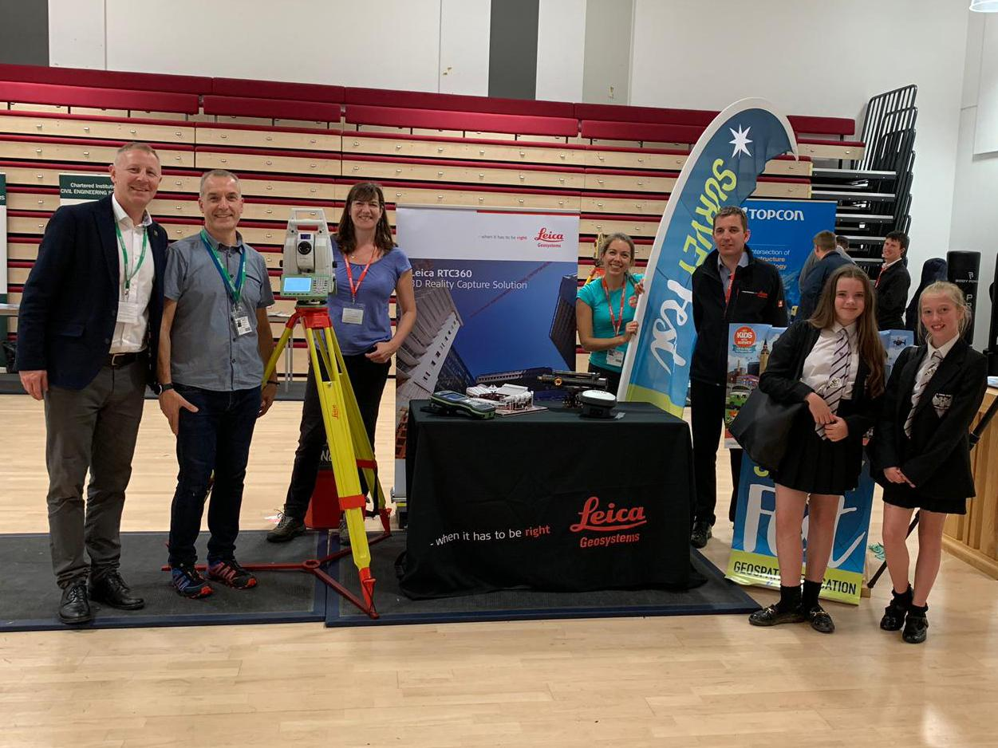
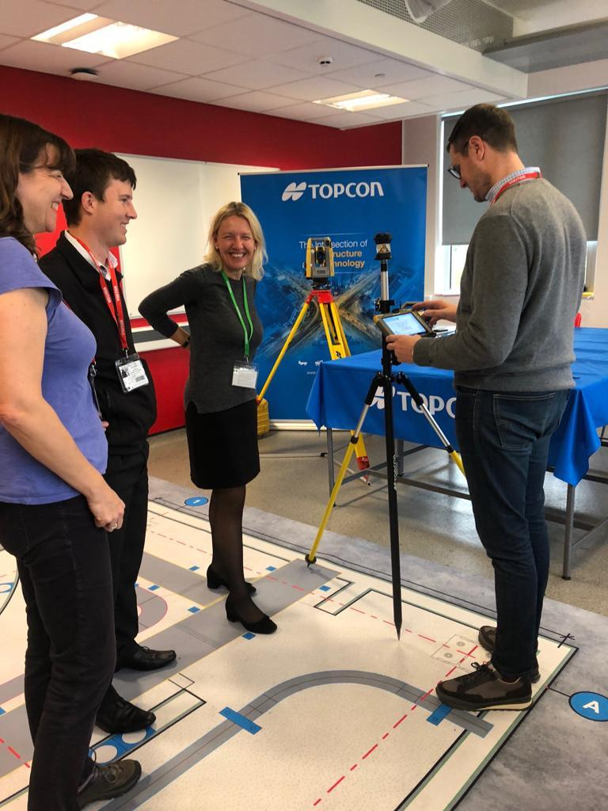
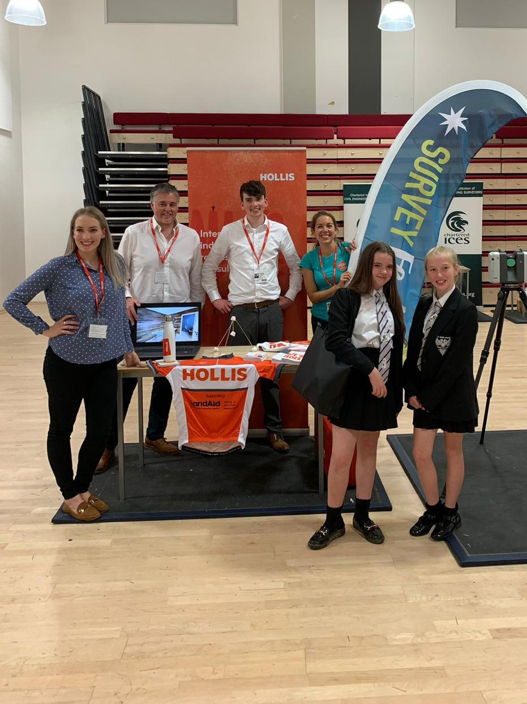
SURVEY Fest Program
& Events
Founding Sponsor
See write up on Topcon

Slide 22
Shows/ Exhibitions
Spreading the word through Industry
GEO Business - thanks to Caroline Hobden
Intergeo - thanks to Daniel Katzer
TopoDOT User Conference (TUC) - thanks to Ted Knaak
Elaine Ball elaine@elaineball.co.uk Tel: +44 (0) 7825-517-850 | Get Kids into Survey is a Registered Trademark

Slide 23

Grow Merchandise / Shop
T-Shirts (2019/2020)
Hats
Backpacks
Stationary
Collectable Cards
Sticker Books
Board Games
Elaine Ball elaine@elaineball.co.uk Tel: +44 (0) 7825-517-850 | Get Kids into Survey is a Registered Trademark

Slide 24

NEW Website End of 2019
Educators Portal
Resources
Downloads
Curriculum
Kids Portal
Games
Activities
Comic Book
Animations
Sponsors Portal
Packages
Posters, AR, Comic Book
Donate Button
Shop
Posters (Free)
T-Shirts (Paid)
Colour in sheets (Free)
Activity Packs (Paid)
Stickers Packs (Paid)
Comic Book (Paid)
Comic Strips (Free)
Map Page to show where our posters are being distributed. (Stats on all poster distribution)
Elaine Ball elaine@elaineball.co.uk Tel: +44 (0) 7825-517-850 | Get Kids into Survey is a Registered Trademark

Slide 25
Articles - more reads….links
Point of Beginning Magazine June 2019
The American Surveyor May 2019
LinkedIn May 2019
The Survey Association UK June 2018
The NSPS USA - BeASurveyor
Murphy Surveys UK
Civil Engineering Surveyor, April 2019
How to Design, Engineer & Construct
Elaine Ball elaine@elaineball.co.uk Tel: +44 (0) 7825-517-850 | Get Kids into Survey is a Registered Trademark

Slide 26

Be a Sponsor/ Help Support….
Click here to see the options / prices for 2019
Or contact: Elaine Ball
elaine@elaineball.co.uk
WhatsApp: +447825517850
Phone: +44 (0)1423 711 513

